Slide 1
Time series
Emanuele Della Valle
Prof. @ Politecnico di Milano
Founder & Partner @ Quantia Consulting
Marco Balduini
Founder & CEO @ Quantia Consulting
Riccardo Tommasini
Prof. @ University of Tartu

Slide 2
What are time series?

Slide 3
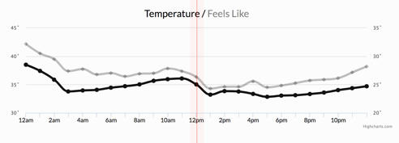
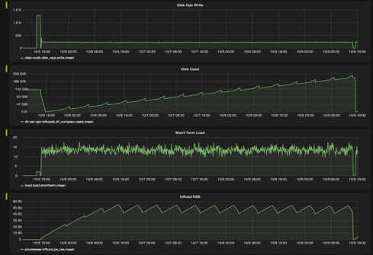
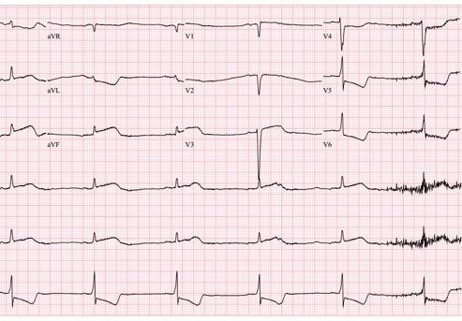
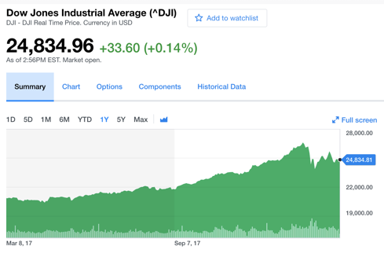
Let’s start by example
Weather conditions
Stock exchange
Cluster monitoring
Healthcare

Slide 4
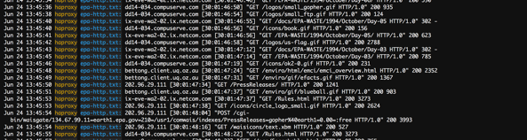
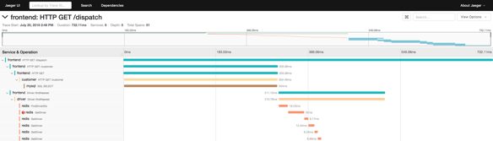
Now some different type of time series
Logs
Traces

Slide 5
What’s the difference?
VS.

Slide 6
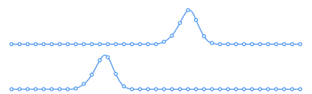
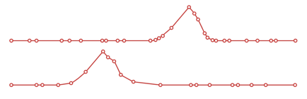
What’s the difference?
both of them are time series, but …
We monitor the phenomena
The phenomena happen and we observe them
regular
irregular
VS.
metrics
events

Slide 7

Metrics
Events
Regular Time Series
Irregular Time Series
Measurements gathered at regular time intervals
Measurements observed at irregular time intervals

Slide 8
Summarization of Events
Events become regular time intervals, for example
Summarizing the average trade price of Apple stock every 10 minutes over the course of a day
Summarizing the average response time for requests in an application over 1 minute intervals

Slide 9
Characteristics of the time series
All Time-stamped data
Generated in
regular (Metric) and
irregular (Event) time periods
Huge volumes of data
High variety of semi-structured data
Real-time
Time sensitive

Slide 10
Who uses time series and how?

Slide 11
Primary Use Cases
IoT
DevOps
Real-Time Analytics
Industrial settings: factories, oil & gas, agriculture, smart roads & infrastructure
Consumer: wearables, consumer devices & trackers
Custom monitoring solutions to track servers, VMs, applications, users or events
Apps that instrument business, social or development metrics in real-time

Slide 12
So what’s a time series DB?

Slide 13
Time series DB
Other DBs
optimized for
collecting
storing
retrieving
processing (historical and real-time)
timestamped & semi-structured data
Traditional relational Databases optimized for storing and querying structured data
Document databases Optimized for storing and retrieving semi-structured JSON documents
Search databases Optimized for storing and retrieving unstructured data (e.g., full-text searches)

Slide 14
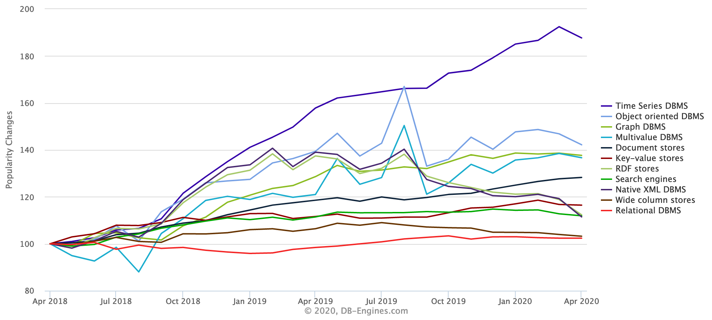
The interest about time series data bases is growing
Time series DB
https://db-engines.com/en/ranking_categories

Slide 15
Time series
Emanuele Della Valle Prof. @ Politecnico di Milano & Partner @ Quantia Consulting
Marco Balduini Founder & CEO @ Quantia Consulting
Riccardo Tommasini Prof. @ University of Tartu

